Slide 1
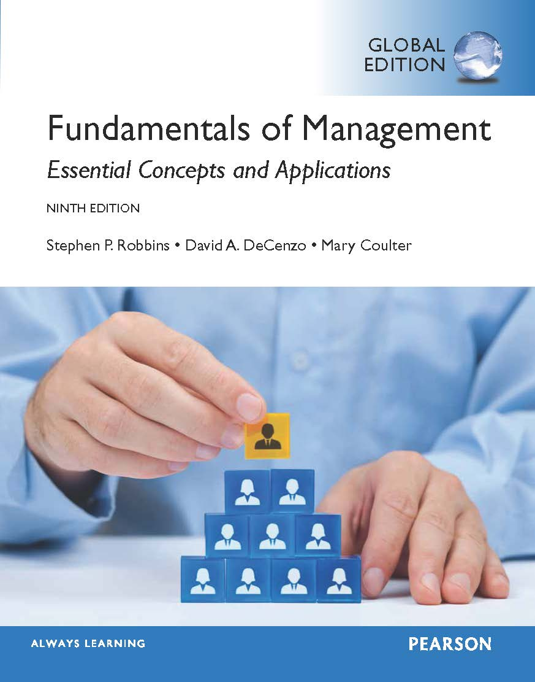
4
Chapter
Foundations
of Decision Making
© Pearson Education Limited 2015
4-<number>

Slide 2
Learning Outcomes
Describe the decision-making process.
Explain the three approaches managers can use to make decisions.
Describe the types of decisions and decision-making conditions managers face.
Discuss group decision-making.
© Pearson Education Limited 2015
4-<number>

Slide 3
4.1
Describe the decision-making process.
© Pearson Education Limited 2015
4-<number>

Slide 4
Decision making is typically described as choosing among alternatives.
    It is too simplistic
  Decision making is a process
© Pearson Education Limited 2015
1-<number>

Slide 5
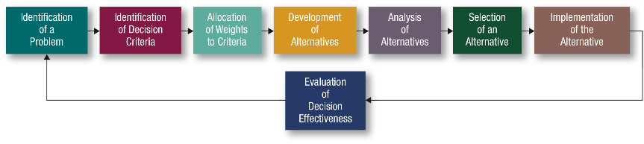
How Do Managers Make Decisions?
© Pearson Education Limited 2015
4-<number>

Slide 6
Identifying a Decision Problem (step 1)
Problem:
a discrepancy between an existing and a desired state of affairs.
Problem identification is subjective.
Ex: a car is no longer worth repairing, then the best decision may be to purchase another car.
© Pearson Education Limited 2015
4-<number>

Slide 7
How do managers become aware of such a discrepancy?
They have to compare the current state of affairs (current reality) with some standard,
  which can be past performance,
  previously set goals,
  or the performance of another unit within the organization or in another organization
  Ex: car-buying example; the standard is previous performance- a car that runs.
1-<number>

Slide 8

Identifying Decision Criteria (step 2)
Relevant Factors:
  Price
  Model (two-door)
  Size (SUV)
  Manufacturer (American, Japanese, German)
  Options (navigation system, leather interior)
  Repair record
© Pearson Education Limited 2015
4-<number>

Slide 9
Note that in this step (identifying decision criteria) in the decision-making process, what is not identified is as important as what is.
  Fuel economy is not a criterion, then it won’t influence choice of car.
Therefore, if a decision maker doesn’t identify a particular factor in Step 2, that factor is irrelevant.
© Pearson Education Limited 2015
1-<number>

Slide 10
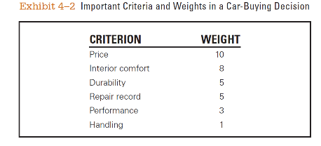
Weighting Criteria (step 3)
Allocate weights to the items listed in Step 2 to factor their relative priority into the decision.
Most important criterion assigned a weight of 10.
Other weights assigned against this standard.
© Pearson Education Limited 2015
4-<number>

Slide 11
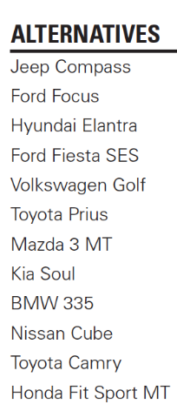
Developing Alternatives (step 4)
In Step 4, the decision maker lists the alternatives that could resolve the problem.
The decision maker only lists the alternatives and does not attempt to appraise them in this step.
© Pearson Education Limited 2015
4-<number>

Slide 12
Analyzing Alternatives (step 5)
Decision maker analyze each alternative by appraising it against the criteria.
The strengths and weaknesses of each alternative become evident when compared with the criteria
© Pearson Education Limited 2015
1-<number>

Slide 13
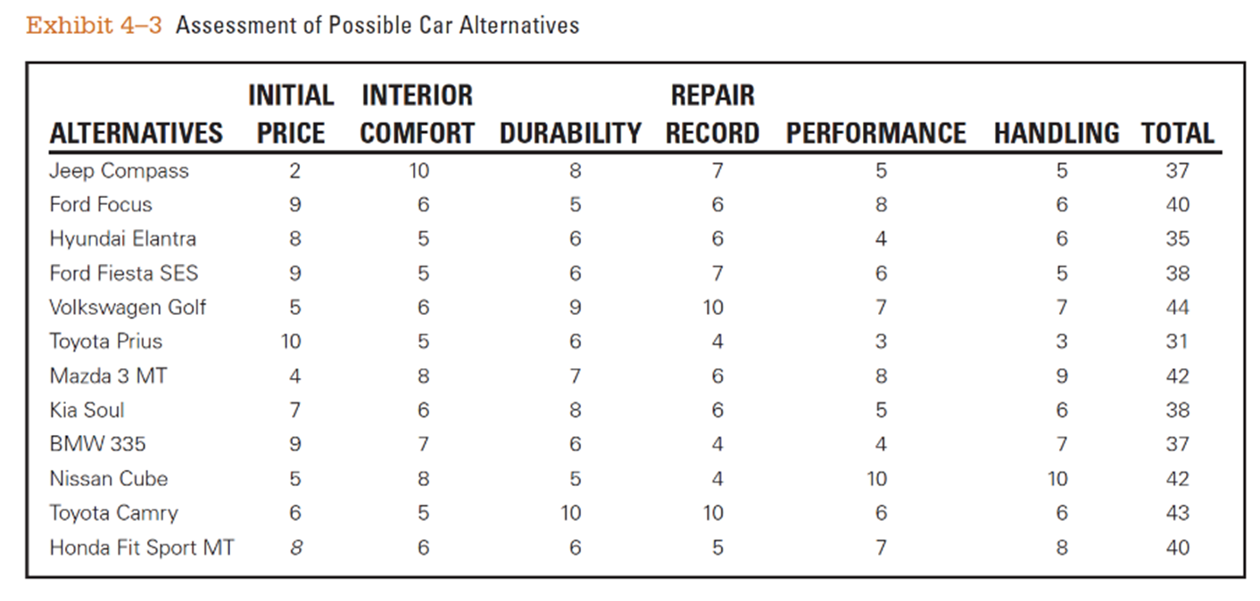
Analyzing Alternatives (step 5)
Exhibit 4–3 shows only an assessment of the 12 alternatives against the decision criteria; it does not reflect the weighting done in step 3.
1-<number>

Slide 14
Some assessments can be achieved objectively,
  purchase price from local dealers
  frequency of repair data as reported by consumer magazine reports, blogs.
The assessment of how the car handles is clearly a personal judgment.
  Assess value after having test-driven each car
© Pearson Education Limited 2015
1-<number>

Slide 15
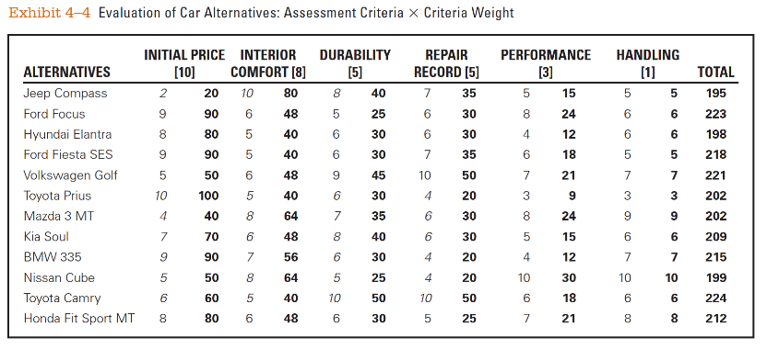
Selecting the Best Alternative (Step 6)
© Pearson Education Limited 2015
4-<number>

Slide 16
Implementing the Decision (step 7)
Decision implementation:
putting a decision into action.
If others will be affected by the decision, implementation includes getting their commitment to it.
  Want people to be committed to a decision?
    Let them participate in the decision-making process
4-<number>

Slide 17
Evaluating the Decision (Step 8)
Appraising the outcome of the decision:
Was the problem resolved?
Did the alternative chosen in Step 6 and implemented in Step 7 accomplish the desired result?
© Pearson Education Limited 2015
4-<number>

Slide 18
Common Errors
When managers make decisions, they use “rules of thumb” or judgmental shortcuts called heuristics to simplify their decision making.
However, rules of thumb are not necessarily reliable and can lead managers into error while processing and evaluating information.
© Pearson Education Limited 2015
1-<number>

Slide 19
Managers want to be good decision makers and exhibit good decision-making behaviors.
  So they appear competent and intelligent to their boss, employees, and coworkers.
© Pearson Education Limited 2015
1-<number>

Slide 20
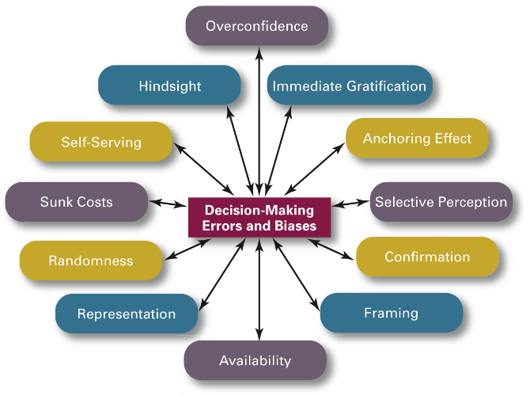
Common Errors
© Pearson Education Limited 2015
4-<number>

Slide 21
Awareness of these biases
  helps managers to identify the heuristics they use (Be aware of them and don’t use them)
  helps managers to avoid their negative effects
  can encourage them to ask colleagues to identify weaknesses in their decision-making style that the managers can then self-correct.
© Pearson Education Limited 2015
1-<number>

Slide 22
4.2
Explain the three approaches managers can use to make decisions.
© Pearson Education Limited 2015
4-<number>

Slide 23
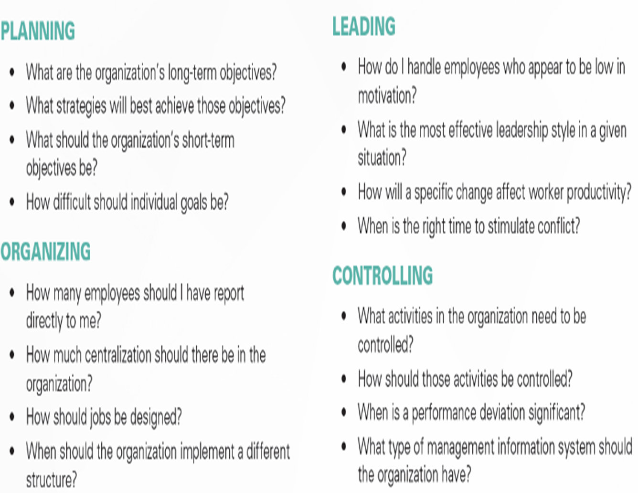
Although everyone makes decisions in an organization, decision making is particularly important to managers and is part of all four managerial functions
1-<number>

Slide 24
Three Approaches Used to Make Decisions: Types of Decisions
1) Rational Model
Rational decision making:
choices that are consistent and value-maximizing within specified constraints.
© Pearson Education Limited 2015
4-<number>

Slide 25
A ‘rational’ decision maker ...
Can we ever be fully objective and logical?
Can problems ever be totally clear and unambiguous?
Can a goal ever be made that clear and specific?
Can all possible alternatives and consequences ever be known?
Can any alternative selected ever maximizes achievement of goal?
Organization’s best interests are considered.
‘ Not. A. Very Realistic Approach’
1-<number>

Slide 26
2) Bounded Rationality
Managers make decisions rationally but are limited (or bounded) by their ability to process information.
  Because they can’t possibly analyze all information on all alternatives,
  Managers satisfice, rather than maximize.
    That is, they accept solutions that are “good enough.”
‘A More Realistic Approach’
© Pearson Education Limited 2015
1-<number>

Slide 27
2) Bounded Rationality
Decision making is influenced by the
  organization’s culture,
  internal politics,
  power considerations,
  escalation of commitment, which is an increased commitment to a previous decision despite evidence that it may have been wrong.
1-<number>

Slide 28

Bounded Rationality
Satisfice
Escalation of commitment
© Pearson Education Limited 2015
4-<number>

Slide 29
3) Intuitive Decision Making
Intuitive decision making - making decisions on the basis of
  experience,
  feelings,
  accumulated judgment
  - Described as ‘unconscious reasoning’
© Pearson Education Limited 2015
1-<number>

Slide 30
- Managers make decisions based on five different aspects of intuition:
  Past experiences
  Feelings and emotions
  Skills, knowledge, and training
  Data from the subconscious
  Ethical values or culture.
© Pearson Education Limited 2015
1-<number>

Slide 31
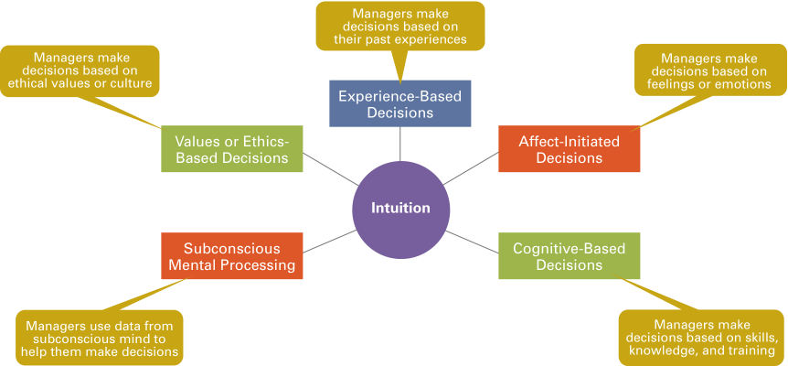
3) Intuitive Decision Making
© Pearson Education Limited 2015
4-<number>
Notes:
described here in Exhibit 4-7.

Slide 32
4.3
Describe the types of decisions and decision-making conditions that managers face.
© Pearson Education Limited 2015
4-<number>

Slide 33
Types of Problems
  Structured problem
  Unstructured problem
© Pearson Education Limited 2015
4-<number>

Slide 34
Structured problem
Some problems are straightforward.
The goal of the decision maker is clear,
the problem is familiar,
information about the problem easily defined and complete.
Examples:
A customer who wants to return an online purchase
A supplier who is late with an important delivery
© Pearson Education Limited 2015
1-<number>

Slide 35
Unstructured problem
Some problems are new or unusual
Information about the problem is ambiquous or incomplete
Examples:
To enter a new market
unproven technology
1-<number>

Slide 36
Types of Decisions
Programmed
Nonprogrammed
© Pearson Education Limited 2015
1-<number>

Slide 37
Types of Decisions
Programmed:
Repetitive decisions that can be handled using a routine approach.
Programmed decision making is the most efficient way to handle structured problems
© Pearson Education Limited 2015
4-<number>

Slide 38
Managers can use three guides for making programmed decisions:
  Systematic procedures
  Rules
A procedure is a series of interrelated sequential steps that a manager can use when responding to a well-structured problem.
A rule is a statement that tells employees what can or cannot be done
© Pearson Education Limited 2015
1-<number>

Slide 39
Types of Decisions (cont.)
Nonprogrammed:
When problems are unstructured, managers rely on nonprogrammed decisions to develop unique solutions.
Examples:
To decide which global market to enter
To create a new organizational strategy
‘A custom-made, a unique, nonrecurring decision- nonprogrammed response is required.’
© Pearson Education Limited 2015
4-<number>

Slide 40
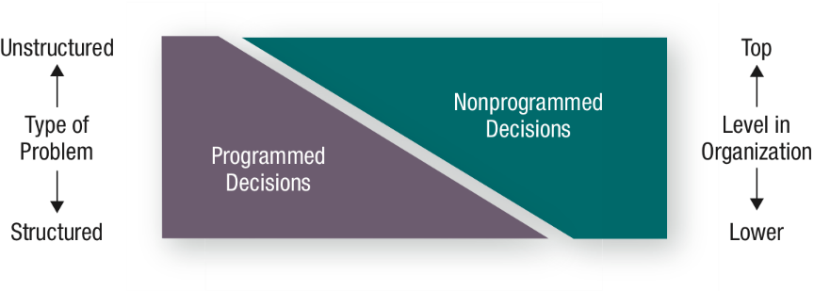
Problems, Decision Types, and Organizational Levels
© Pearson Education Limited 2015
4-<number>

Slide 41
Decision-Making Conditions
  Certainty ; a manager can make accurate decisions because the outcome of every alternative is known.
  Risk; the decision maker is able to estimate the likelihood of certain outcomes based on data from past personal experiences or secondary information.
    lets the manager assign probabilities to different alternatives.
  Uncertainty; that the decision maker can’t even make reasonable probability estimates.
    The choice of alternatives is influenced by the limited amount of information and by the psychological orientation of the decision maker.
4-<number>

Slide 42
4.4
Discuss group decision-making.
© Pearson Education Limited 2015
4-<number>

Slide 43
How Do Groups Make Decisions?
Decisions are often made by groups representing the people who will be most affected by those decisions.
  Committees
  Task forces
  Review panels
  Work teams
© Pearson Education Limited 2015
4-<number>

Slide 44
Advantages of Group Decision Making
  More complete information
  Diversity of experiences/perspectives
  More alternatives generated due to greater quantity and diversity of information, especially when group members represent different specialties.
  Increased acceptance of solution by having people who will help implement it participate in the decision.
  Increased legitimacy because the group decision-making process is consistent with democratic ideals
4-<number>
Notes:
autocratic and arbitrary.

Slide 45
Groupthink
When a group exerts extensive pressure on an individual to withhold his or her different views in order to appear to be in agreement.
  What it does
  How it occurs
  How to minimize it
© Pearson Education Limited 2015
4-<number>

Slide 46
Groupthink
What it does
  Discourage individuals from critically appraising unusual, minority, or unpopular views.
How it occurs
  Members pressure those who express doubts about the majority’s arguments
  An illusion appers. Full agreement is assumed if no one speaks.
How to minimize it
  Foster open discussion
  Have a leader who seeks input from all members
1-<number>

Slide 47
When Are Groups Most Effective?
Whether groups are more effective than individuals depends on the criteria used for defining effectiveness,
  accuracy
  speed
  creativity
  acceptance
© Pearson Education Limited 2015
1-<number>

Slide 48
When Are Groups Most Effective?
Individual
Faster decision making
More efficient use of work hours
Group
More accurate decisions
More creative
More heterogeneous representation
Greater acceptance of final solution
© Pearson Education Limited 2015
4-<number>

Slide 49
Improving Group Decision Making
Make group decisions more creative by:
    Brainstorming
    Electronic meetings
© Pearson Education Limited 2015
4-<number>

Slide 50
Brainstorming is an idea-generating process that encourages all alternatives while withholding any criticism of those alternatives.
The group leader states the problem clearly and members then “freewheel” as many alternatives as they can in a given time and all alternatives are recorded for later discussion and analysis.
1-<number>

Slide 51
The electronic meeting Numerous people sit around a table with a computer.
Issues are presented to the participants, who anonymously type their responses onto their computer screens that are displayed on a projection screen.
The major advantages of electronic meetings are anonymity, honesty, speed, and cost effectiveness.
Discussions do not digress and many participants can “talk” at once without interrupting the others.
1-<number>

Slide 52
The videoconference is a variant, linking media and people from different locations, increasing the efficiency with which decisions are made.
  Save hours of business travel
  Save money (Nestlé, Logitech)
© Pearson Education Limited 2015
1-<number>

Slide 53
4.5
Discuss contemporary issues in managerial decision making.
© Pearson Education Limited 2015
4-<number>

Slide 54
Contemporary Issues
Decision-making differ from country to country
National culture influences
The way decisions are made whether by group or team members
The degree of risk a decision maker is willing to take
© Pearson Education Limited 2015
4-<number>

Slide 55
In India, power distance and uncertainty avoidance are high.
  There, only very senior –level managers make decisions, and they make safe decisions.
In Sweden, power distance and uncertainty avoidance are low.
  Swedish managers are not afraid to make risky decsions.
  Senior managers push decisions down to lower levels.
© Pearson Education Limited 2015
1-<number>

